Slide 1

Getting Started to Build Applications with React
Adhithi Ravichandran
Software Consultant, Author, Speaker
@AdhithiRavi www.adhithiravichandran.com

Slide 2

Prerequisites
- JavaScript
- ES2017 basic knowledge
- HTML
- CSS

Slide 3
Code in JavaScript

Slide 4
According to Stack Overflow's Annual Survey of 2022, for the 10th year in a row, JavaScript is ranked as the most commonly used programming language.

Slide 5
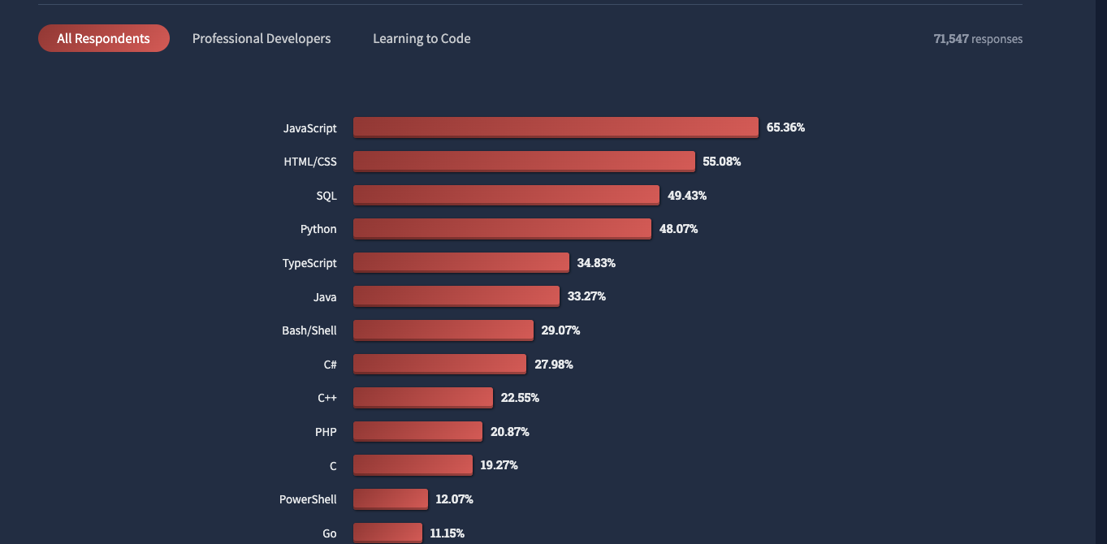
Stack Overflow Survey Results 2022

Slide 6
What is React?

Slide 7
React is a JavaScript library for building rich user interfaces.
Notes:
It is more than just cultural awareness and sensitivity.

Slide 8
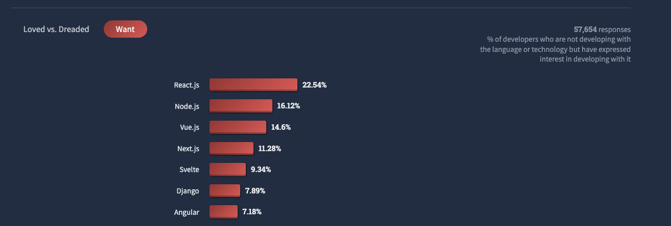
Most Wanted Web Frameworks 2022
React.js completes its fifth year as most wanted in the stack overflow developer survey!

Slide 9
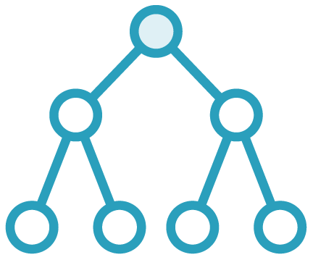
Component-based architecture
Reuse of components
One directional data flow
Everything Is a Component

Slide 10

Offers lots of flexibility
Freedom to choose state management, navigation, server-side rendering and more
Flexibility

Slide 11


Framework vs. Library
Angular
React

Slide 12

Ease of testing
Plenty of testing options like Jest, Cypress, etc..
Testing Is Fun

Slide 13

Seamless UI
Highly responsive and rich UI
Quick loading times enabling a smooth user experience
Builds Rich UI

Slide 14


Code sharing between web and mobile
Saves cost of development and maintenance
Code Sharing

Slide 15
React Components

Slide 16
Components
Components let you split the UI into independent, reusable pieces that are easier to write, test, and maintain.

Slide 17
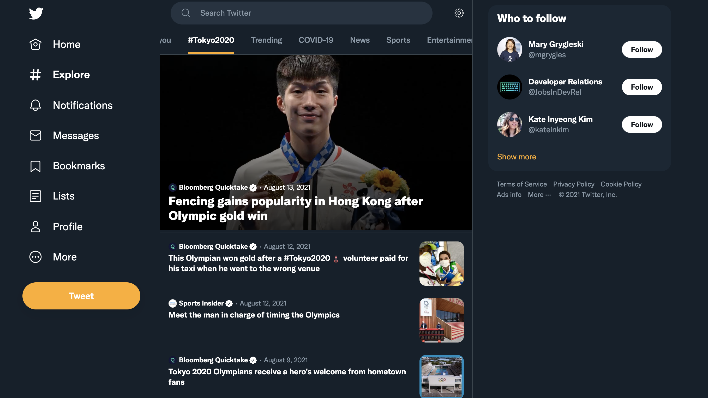

Slide 18
Components Structure
App
NavBar
SearchBar
Suggestion
Feed
Follow
Tweet
Like

Slide 19
Each component is a building block that is a reusable piece of UI. Putting them together results in a complete application!

Slide 20
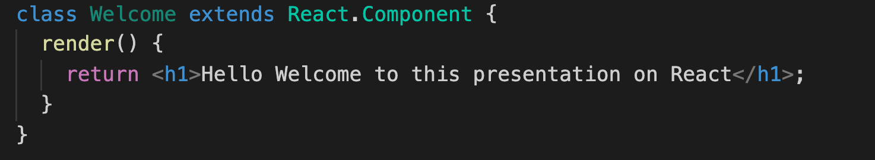
React Component
Define a component as an ES6 class

Slide 21
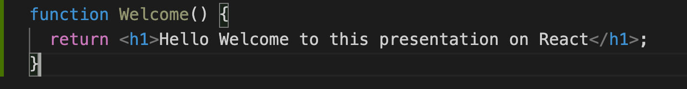
React Component
Define a component with a JS function.

Slide 22
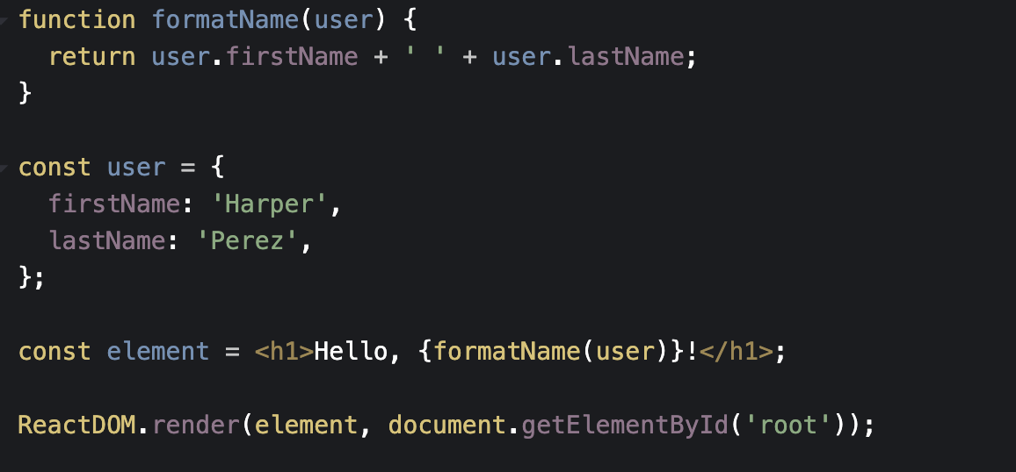
JSX
JSX - JavaScript Expressions, not HTML
It is a syntax extension to JavaScript
Can use JSX inside if statements, for loops, accept is as arguments, and return it from functions!

Slide 23
Use Functional Components

Slide 24

Class components are a story of the past
Class components are confusing to people and machines

Slide 25

Write React Functional Components
Simpler to learn and write
Less code
Easier to maintain and test
Hooks

Slide 26
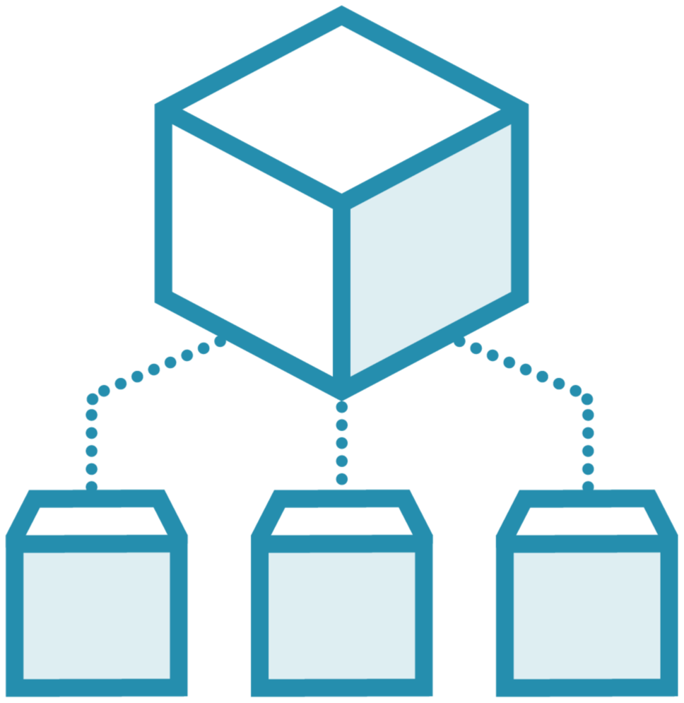
Props
Props are short for Properties.
Components receive props from their parent.
Props are unchangeable within the component using it.
It helps you write reusable code.

Slide 27
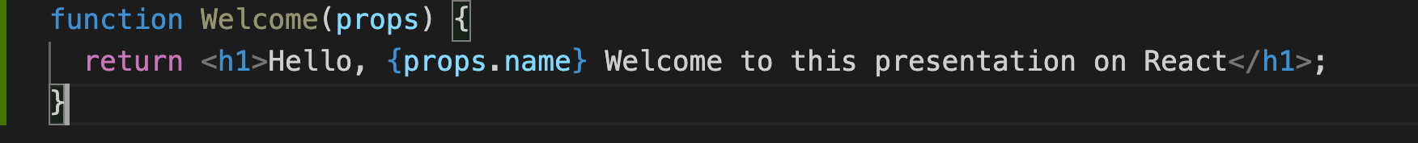
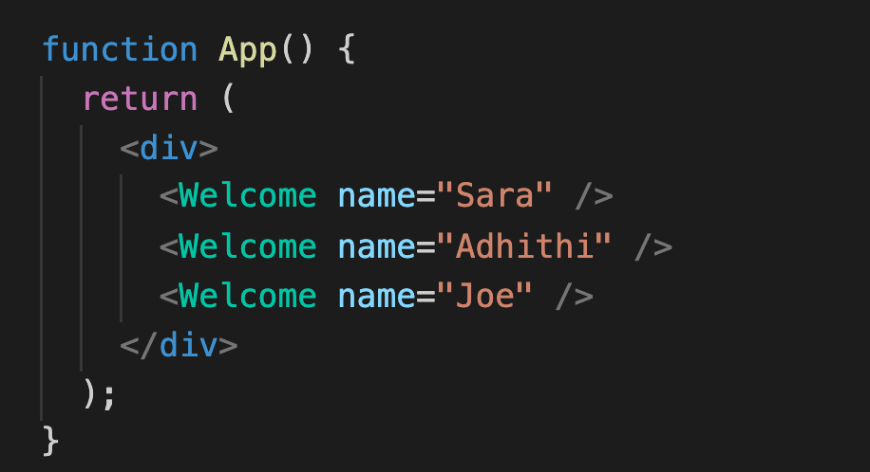
Passing Props to Components
Welcome component accepts props.
App component calls Welcome and passes props.
Different props can be passed each time Welcome is called.
Props are ready-only inside Welcome component.

Slide 28

State
State is internal to a component.
State can change within the component.
Anytime there is data that is going to change within a component – use state!

Slide 29
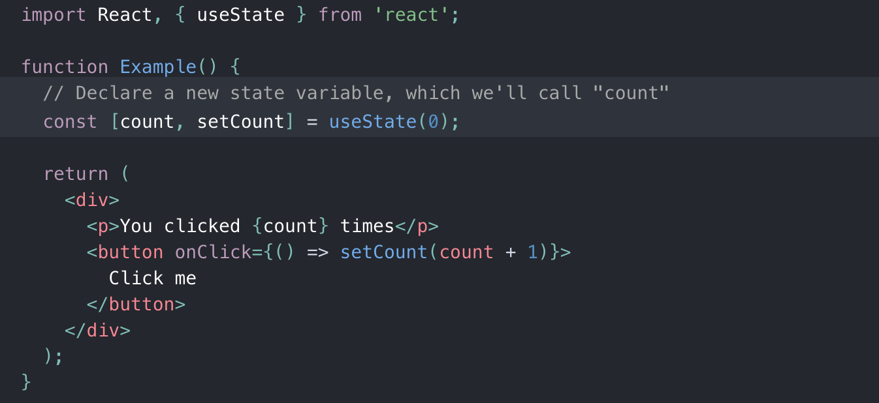
Using State within Components
State is internal to component and can change within the component.

Slide 30
React – “reacts” to state changes!

Slide 31
Hook is a special function that let’s you hook into React features, within functional components!

Slide 32
useState Hook
Declares state variable.
Returns pair of values: current state and the function that updates it.

Slide 33
Break down your components – when needed!

Slide 34





When do I break down components?
Managing state is a nightmare
Performance concerns with re-rendering of application
Code readability takes a hit
Working with multiple developers on the codebase becomes challenging
Testing code is harder

Slide 35
Start with local state!

Slide 36
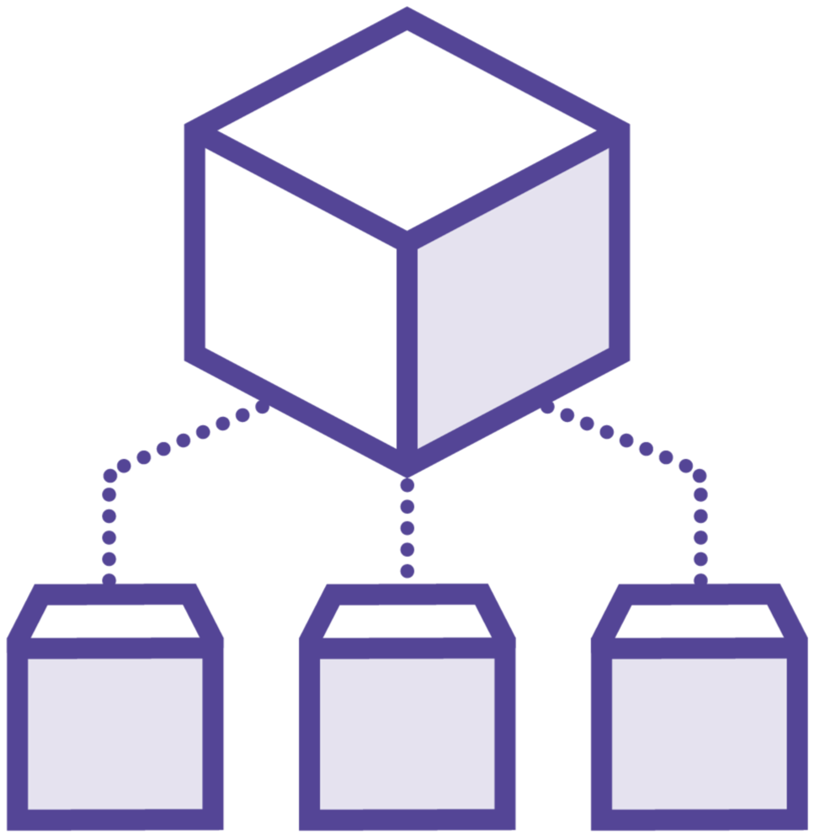


State Management
Start with local state first
Pass down state via props if child component needs it
Lift state up if non-child component needs the data
Next choice: Context or external state management

Slide 37
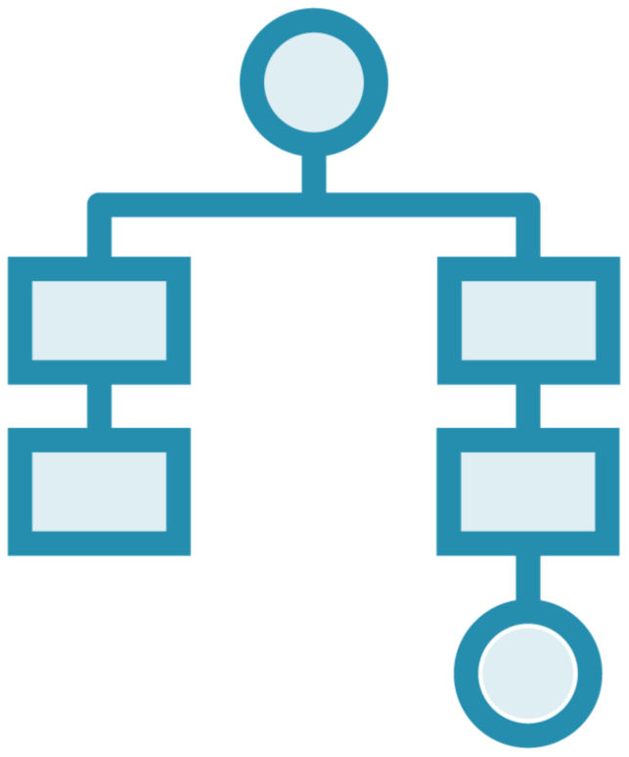
useContext Hook
Context is designed to share data that is global for a tree of React components.
Avoid passing props through multiple layers of components.
Examples: Theme, demographic information, language, etc..

Slide 38
Easy setup with Create React Apps

Slide 39
Create React App
npx create-react-app project

Slide 40
Lesson 3: TypeScript is a life saver!

Slide 41
Why TypeScript?
Catch problems early on
Intellisense is accurate
Easier to refactor code
Readable code
Easier to maintain and test
High quality documentation (TSDoc)

Slide 42
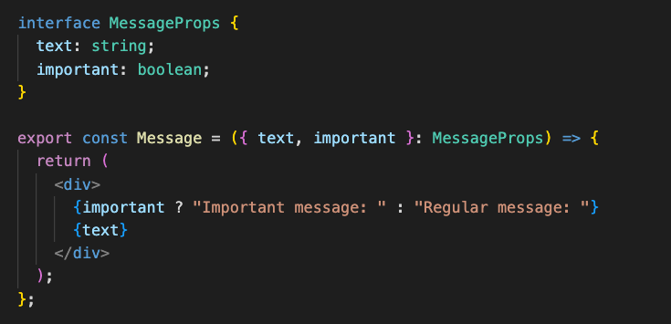
Component in TypeScript
Interface defines the props that are accepted by the component using an object type
MessageProps is the interface that describes the props the component accepts

Slide 43
Test, Test and Test!

Slide 44


Types of Testing
Unit testing - Jest
Component testing – React testing library
Automated End-to-end tests - Cypress

Slide 45
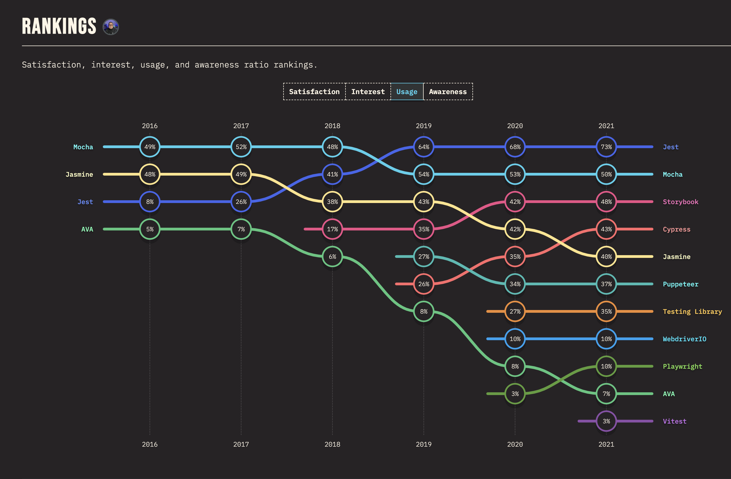
State of JS Survey 2021

Slide 46


Slide 47

Developer Decisions
Routing
Data fetching
Server-side rendering
Search Engine Optimization
Image Optimization
Bundling
Code Splitting
Deployment

Slide 48

What is Next.js?
Next.js is a flexible React framework that gives you building blocks to create fast web applications

Slide 49





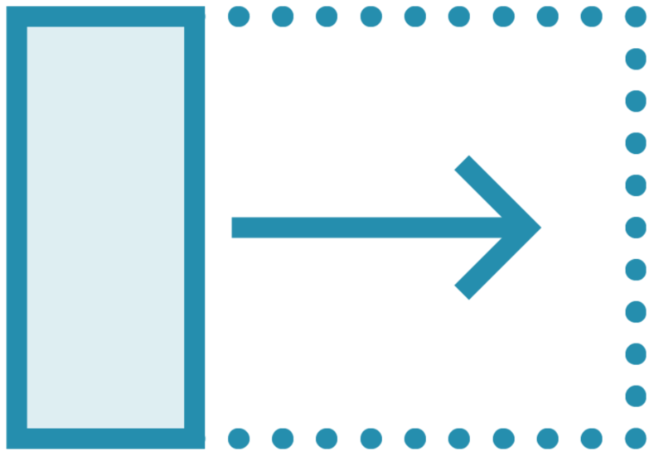
Next Features
File-system Routing
Image and font optimization
Hybrid: SSG and SSR
Automatic bundle splitting and lazy loading
Incremental Static Regeneration
Automatic TypeScript support

Slide 50
Next.js is a React Framework for Production

Slide 51
Thank You!

Slide 52
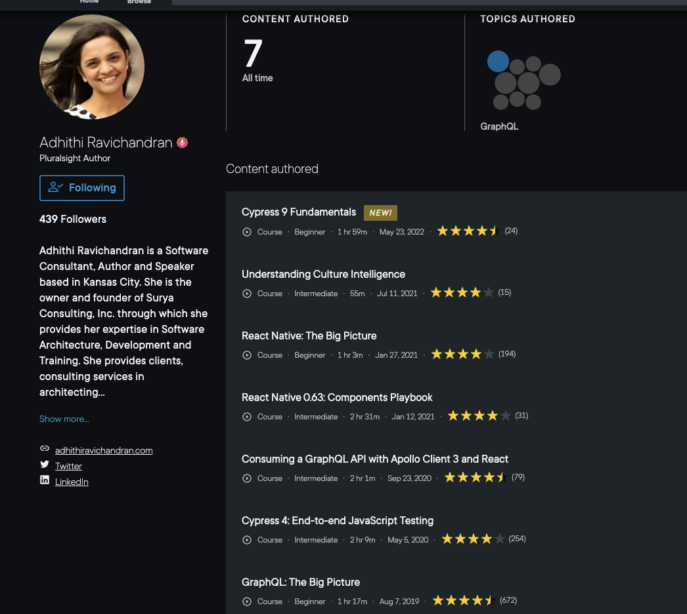
Checkout my courses on Pluralsight on React Native, GraphQL, Cypress, etc..

Slide 53
@AdhithiRavi

